Slide 1
Minimizing Operator Workload & Maximizing Operator Efficiency
Michael A. Goodrich
Eric G. Mercer
Computer Science Department, BYU

Slide 2
Project Goal
Develop a simulation based workload measure suitable for iterative analysis in human computer interface design with a goal to minimize operator workload.

Slide 3
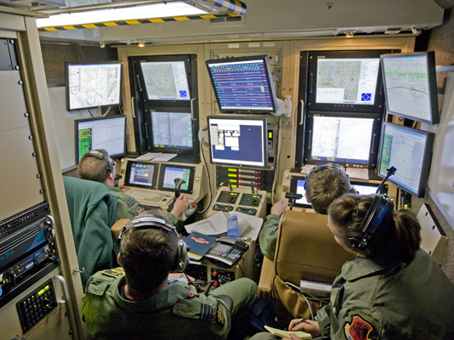
Notes:
Example use case:
As flight deck automation continues to evolve, airline operators and manufacturers have begun to explore concepts to further reduce crew size in large transport aircraft to a single pilot. If alternative methods could be found for supporting the remaining high-workload portions of the flight (e.g., takeoff, approach and landing), single-pilot operations (SPO) could potentially reduce operating costs for the air- line operators. Any transition from current two pilot operations (TPO) to SPO, however, must maintain at least current levels of safety while maximizing cost savings. Research into SPO concepts has focused on increasing flight deck automation, adding ground-based assets to support the lone pilot, or, more commonly, some combination of these approaches. In most SPO concepts, a ground operator would support a lone pilot specifically during high-workload phases of a flight, thus allowing a single ground operator to potentially support multiple flights, thereby reducing overall crewing requirements. However, operating as a distributed team can result in communication breakdowns that require additional coordination [4].

Slide 4
Progress to Date
Discrete event model for human computer teaming
Cognitive based workload measures in discrete event models
Workload analysis of wilderness search and rescue (WiSAR)
Model to integrate WiSAR in the national airspace
T.J. Gledhill, “Modeling Human Workload in Unmanned Aerial Systems”, M.S. Thesis, BYU, 2014.
J. Moore, R. Ivie, T.J. Gledhill, E. Mercer, and M. Goodrich. “Modeling Human Workload in Un- manned Aerial Systems”, in AAAI 2014 Spring Symposia, Formal Verification and Modeling in Human- Machine Systems, CA, March, 2014.
T. J. Gledhill, E. Mercer, and M. A. Goodrich, “Modeling UASs for Role Fusion and Human Machine Interface Optimization”, Proceedings of the IEEE International Conference on Systems, Man, and Cybernetics, 2013.

Slide 5
New Since Last IAB Meeting
Definition of workload in belief-desires-intentions (BDI) architectures
Implementation in the Brahms BDI language
Case study on a single pilot operation model
User study to validate workload measures
R. Stocker, N. Rungta, E. G. Mercer, F. Raimondi, J. Holbrook, C. Cardoza, and M. A.Goodrich, An Approach to Quantify Workload in a System of Agents. To appear in Proceedings of the 14th International Conference on Autonomous Agents and Multiagent Systems, Istanbul, Turkey, May 2015.

Slide 6
Other Notables
2014 Spring AAAI Symposium on Formal Verification in Human-machine Systems
IEEE Transactions on Human-Machine Systems, Special Issue on “Systematic Approaches to Human- Machine Interface: Improving Resilience, Robustness, and Stability”, 2014

Slide 7
Brief Review of Previous Work

Slide 8
Directed Team Graph
Visual
Bob
Audio
Alice
Visual
Audio
Notes:
Everything schedules on the event simulator.

Slide 9
Discrete Event Simulator
Visual
Bob
Audio
Alice
Visual
Audio
Events
Update on Event
Events
Discrete Event
Simulator
Notes:
Everything schedules on the event simulator.

Slide 10
Directed Role Graph
Memory
DESIRE = 10
Vo
Bob
Ao
c1
Vi
IDLE
WAVE
Ai
c2
c4
c3
SPEAK
Notes:
Everything schedules on the event simulator.

Slide 11
Workload
Temporal
Algorithmic
Cognitive

Slide 12
Temporal Workload in Model
PS
IDLE
WAVE
SPEAK
Bob
V_{o}
WAVE
A_{o}
HELLO
PS
IDLE
WAVE
IDLE
Alice
V_{o}
WAVE
A_{o}
HELLO
6 fired transitions
Notes:
Largely a measure of operation tempo: Sliding window that counts transitions

Slide 13
Temporal Workload in Model
PS
IDLE
WAVE
SPEAK
Bob
V_{o}
WAVE
A_{o}
HELLO
PS
IDLE
WAVE
IDLE
Alice
V_{o}
WAVE
A_{o}
HELLO
4 fired transitions
Notes:
Largely a measure of operation tempo: Sliding window that counts transitions

Slide 14
Temporal Workload in Model
PS
IDLE
WAVE
SPEAK
Bob
V_{o}
WAVE
A_{o}
HELLO
PS
IDLE
WAVE
IDLE
Alice
V_{o}
WAVE
A_{o}
HELLO
4 fired transitions
Notes:
Largely a measure of operation tempo: Sliding window that counts transitions

Slide 15
Temporal Workload in Model
PS
IDLE
WAVE
SPEAK
Bob
V_{o}
WAVE
A_{o}
HELLO
PS
IDLE
WAVE
IDLE
Alice
V_{o}
WAVE
A_{o}
HELLO
6 fired transitions
Notes:
Largely a measure of operation tempo: Sliding window that counts transitions

Slide 16
Temporal Workload in Model
PS
IDLE
WAVE
SPEAK
Bob
V_{o}
WAVE
A_{o}
HELLO
PS
IDLE
WAVE
IDLE
Alice
V_{o}
WAVE
A_{o}
HELLO
6 fired transitions
Notes:
Largely a measure of operation tempo: Sliding window that counts transitions

Slide 17
Temporal Workload in Model
PS
IDLE
WAVE
SPEAK
Bob
V_{o}
WAVE
A_{o}
HELLO
PS
IDLE
WAVE
IDLE
Alice
V_{o}
WAVE
A_{o}
HELLO
6 fired transitions
Notes:
Largely a measure of operation tempo: Sliding window that counts transitions

Slide 18
Temporal Workload in Model
PS
IDLE
WAVE
SPEAK
Bob
V_{o}
WAVE
A_{o}
HELLO
PS
IDLE
WAVE
IDLE
Alice
V_{o}
WAVE
A_{o}
HELLO
8 fired transitions
Notes:
Largely a measure of operation tempo: Sliding window that counts transitions

Slide 19
Cognitive Workload in Model
PS
IDLE
WAVE
SPEAK
Bob
V_{o}
WAVE
A_{o}
HELLO
PS
IDLE
WAVE
IDLE
Alice
V_{o}
WAVE
A_{o}
HELLO
0 Active Inputs
Notes:
Count the number of active inputs at each point in time (every output is an input somewhere). Only count at the interface of certain actors.

Slide 20
Cognitive Workload in Model
PS
IDLE
WAVE
SPEAK
Bob
V_{o}
WAVE
A_{o}
HELLO
PS
IDLE
WAVE
IDLE
Alice
V_{o}
WAVE
A_{o}
HELLO
1 Active Inputs

Slide 21
Cognitive Workload in Model
PS
IDLE
WAVE
SPEAK
Bob
V_{o}
WAVE
A_{o}
HELLO
PS
IDLE
WAVE
IDLE
Alice
V_{o}
WAVE
A_{o}
HELLO
1 Active Inputs

Slide 22
Cognitive Workload in Model
PS
IDLE
WAVE
SPEAK
Bob
V_{o}
WAVE
A_{o}
HELLO
PS
IDLE
WAVE
IDLE
Alice
V_{o}
WAVE
A_{o}
HELLO
1 Active Inputs

Slide 23
Cognitive Workload in Model
PS
IDLE
WAVE
SPEAK
Bob
V_{o}
WAVE
A_{o}
HELLO
PS
IDLE
WAVE
IDLE
Alice
V_{o}
WAVE
A_{o}
HELLO
1 Active Inputs

Slide 24
Cognitive Workload in Model
PS
IDLE
WAVE
SPEAK
Bob
V_{o}
WAVE
A_{o}
HELLO
PS
IDLE
WAVE
IDLE
Alice
V_{o}
WAVE
A_{o}
HELLO
1 Active Inputs

Slide 25
Cognitive Workload in Model
PS
IDLE
WAVE
SPEAK
Bob
V_{o}
WAVE
A_{o}
HELLO
PS
IDLE
WAVE
IDLE
Alice
V_{o}
WAVE
A_{o}
HELLO
2 Active Inputs

Slide 26
Cognitive Workload in Model
PS
IDLE
WAVE
SPEAK
Bob
V_{o}
WAVE
A_{o}
HELLO
PS
IDLE
WAVE
IDLE
Alice
V_{o}
WAVE
A_{o}
HELLO
2 Active Inputs

Slide 27
Algorithmic Workload in Model
PS
IDLE
IDLE
Bob
V_{o}
A_{o}
PS
IDLE
Alice
V_{o}
A_{o}
Working over 5 time units
Nothing Fired
Notes:
Crude abstraction of algorithmic complexity. It took some amount of time to be ready to fire a transition.
Increment a counter in each time bucket if an actor is working. Otherwise leave it alone.
Must measure per-actor back from fired transition over the duration.

Slide 28
Algorithmic Workload in Model
PS
IDLE
WAVE
Bob
V_{o}
WAVE
A_{o}
PS
IDLE
Alice
V_{o}
A_{o}
Working over 2 time units
Nothing Fired
Notes:
Crude abstraction of algorithmic complexity. It took some amount of time to be ready to fire a transition.

Slide 29
Algorithmic Workload in Model
PS
IDLE
WAVE
IDLE
Bob
V_{o}
WAVE
SAD
A_{o}
PS
IDLE
IDLE
Alice
V_{o}
A_{o}
Nothing Fired
Working over 3 time units
Notes:
It is a causal relationship.

Slide 30
Algorithmic Workload in Model
PS
IDLE
WAVE
IDLE
Bob
V_{o}
WAVE
SAD
A_{o}
PS
IDLE
WAVE
Alice
V_{o}
WAVE
A_{o}
Nothing Fired
Working over 2 time units
Notes:
Once a transition fires, it looks back and marks where it was working.

Slide 31
Resolving Non-determinism
Many Executions
Java Pathfinder
Non-Deterministic Model

Slide 32
Finding Workload Extremes
Instantaneous
Workload
Cumulative Workload
Time
Find Paths that Max/Min Cumulative Workload

Slide 33
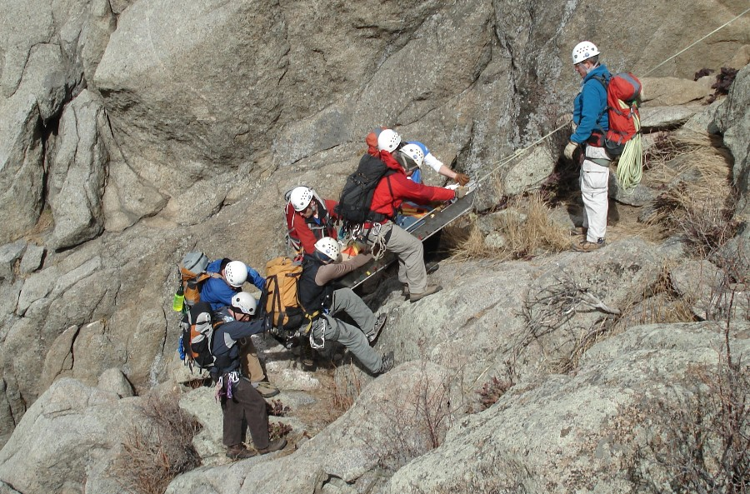
WiSAR

Slide 34
WiSAR Model Statistics
Actor Name | Number of States | Number of Transitions
Parent Search | 5 | 19
Mission Manager | 16 | 56
Payload Operator | 13 | 45
UAV Operator | 13 | 80
Abstraction | 22 | 63

Slide 35
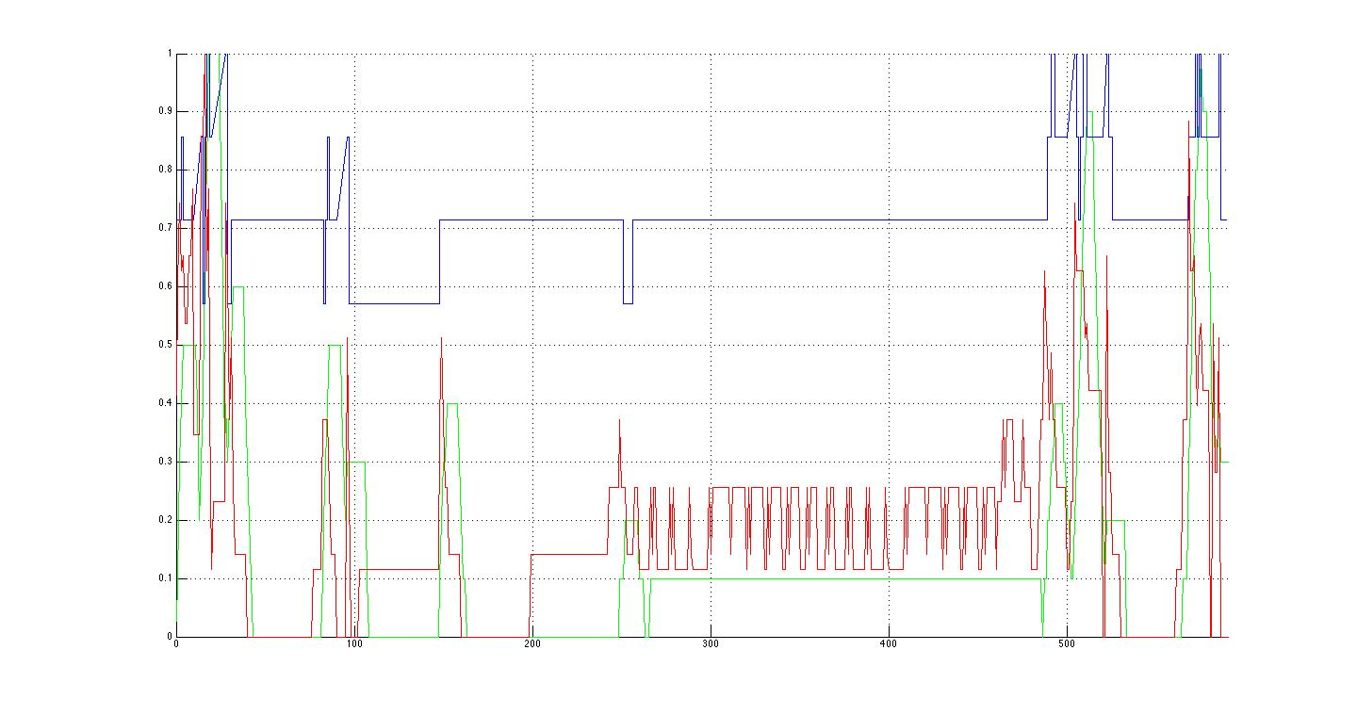
Results for Target Spotted
Cognitive
Temporal
Algorithmic
Land
Report
Flight plan
Monitoring
Notes:
First blue peak is the MM talking to the PS(Area of Interest)
The first green peak is the OP listening to the MM but he is quickly ignored as the MM realizes he needs more info from the PS(target description)
gap between early peaks(MM tells VO the target description first)
MM finally tells the OP the area to search resulting in second set of peaks.
large green peak around 160 - launching the UAV.
Medium green peaks at 260 - putting in the search area(it took awhile to enter, complicated flight plan)
green peaks in the middle are just controlling the UAV, alternating between gui control and direct control.
Blue peaks that come next are due to OP reporting flight completion.
high peak following is the MM reporting to the PS the search completion.
Green peak is landing
Final blue peak is the communication of the target sighting from the VO to the MM to the PS.

Slide 36
Workload in Systems of Agents
New Stuff

Slide 37
Beliefs-Desires-Intentions Architecture
Captures agents mental model of information, motivation, deliberation [Rao, Georgeff, 91]
Based in human practical reasoning
Beliefs: what the agent believes to be true
Desires: what the agent aims to achieve
Intentions: accomplish desires using beliefs
Most successful model for rational agents
Brahms is a NASA language for BDI modeling

Slide 38
The Brahms Language
Agents detect changes and update beliefs
Tasks are represented by workframes
Primitive activities advance time with no update
Communication and broadcast update state
Priorities suspend workframes for multitasking
Also detect changes in environment and switch
Composite activities group related workframes

Slide 39
Ask the modeler to weight each Brahms construct to indicate difficulty and then observe the simulation to categorize events into instantaneous workload measures
Notes:
Basic idea for measuring workload

Slide 40
Revisiting Wicken’s Model

Slide 41
Workload
Temporal
Decision
Perception

Slide 42
Perceptual Workload in BDI
Intuition: relevant signals broadcast over the same input, and the burden to store and integrate those signals into an accurate awareness of the situation
Weighted number of updates to beliefs (concludes) related to perception: sight, sound, haptic, etc.
Notes:
Updates in Brahms relate to concludes, detectables in workframes, and communication actions. The isP() returns true if the update is due to perception. Right now, in Brahms, every conclude, detectable, and workframe is counted.

Slide 43
Decision Workload in BDI
Intuition: encodes the burden placed on working memory and executive control as a function of the difficulty of task selection with a fixed expertise level
Weighted number of task choices (all the workframes that have their guard conditions satisfied)

Slide 44
Temporal Workload in BDI
Intuition: the burden placed on memory, attentional resources, executive functions, and interference effects in a multi-tasking context
Weighted number of tasks (workframes) executed including suspended and impassed workframes
Notes:
Work-frame: one being executed
Suspended: paused work-frame due to a higher priority work-frame being enabled
Impasse: a paused work-frame due to a detectable condition (will be started again once the condition is false).

Slide 45
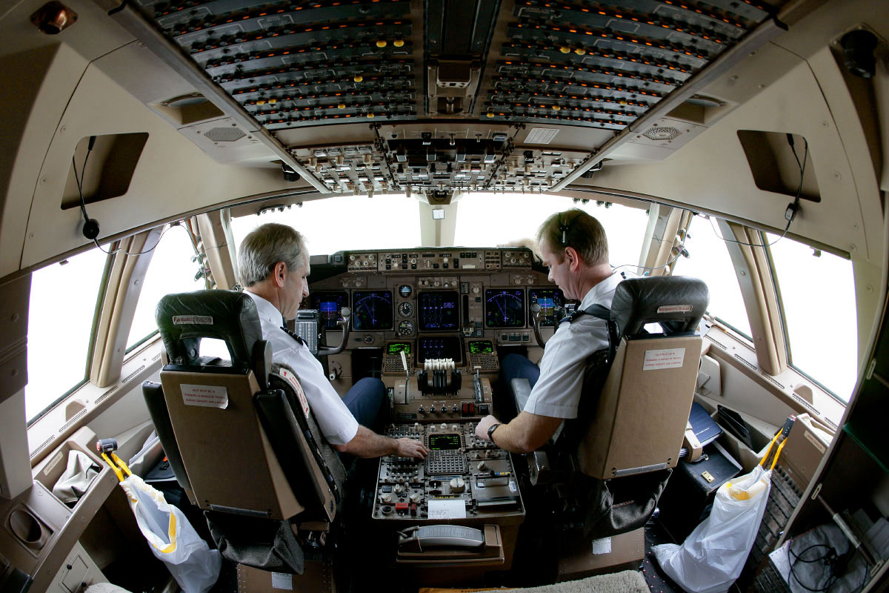
Notes:
The two-pilot scenario is that of a nominal approach from five miles out and 2000 feet up. The pilot is the person actually flying the plane, interacts with controls of the plane, reads values off the instruments and communicates with the first-officer who is monitoring. There are no off-nominal conditions possible in the model. There are several activities performed by the pilot that are over the visual and audio perception channels, such as communications from the pilot monitoring and reading values off instruments. The pilot is often also choosing between a variety of tasks with the same priority such as checking instruments and communicating with the first officer. The pilot can also be required to multitask on several occasions due to incoming alerts or readings which require the pilot to temporarily switch tasks.

Slide 46
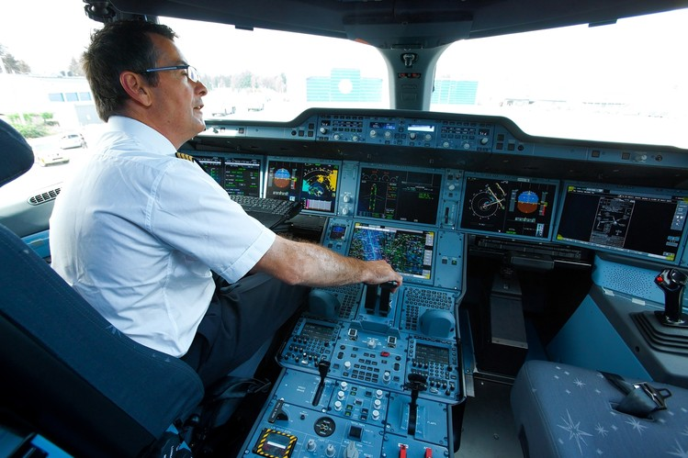
Notes:
The SPO model is a duplication of the two-pilot model with some minor adjustments. Note that this is by design, our goal was to minimize the number of differences between a SPO model and a two-pilot model. The pilot essentially performs the same tasks in a SPO as in a two-pilot scenario, but instead of communicating with the first-officer on board, the pilot is communicating with an operator on the ground. We assume that the operator on the ground is able to access the same instrument data that would have been available to the first officer. The ground operator, however, may be lacking certain situational awareness. e.g., the operator on the ground is unable to feel the movement of the plane and may not realize fluctuations in readings due to wind shear. The ground operator may request additional information from the pilot which a first officer in a two-pilot scenario would not. To model the effect of high winds, we add conditions that impact the stability of the plane. The pilot has to then adjust the configuration of the plane and make attempts to stabilize the plane, adjust power, and adjust yoke.

Slide 47
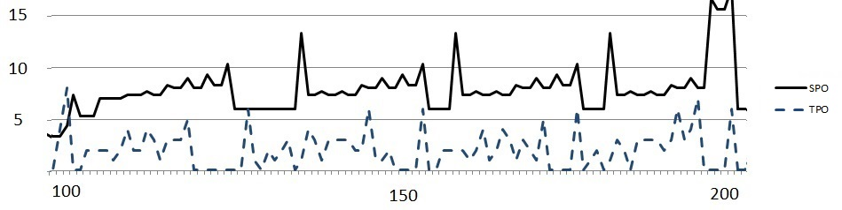
Perception Workload
p-value = 0.0002
Notes:
Shows the comparison between perceptual workload during the flight phase 1500 and 1000 feet. We plot the values of workload on the y-axis while we plot the time in the simulation on the x-axis. During this phase of flight the pilot is manipulating flight controls, performing energy managements such as reducing the speed of the aircraft, and also monitoring the flight instruments. Toward time 180 there is a spike in the perceptual workload of the SPO. During this stage of the flight the pilot flying forgets to extend gears and the first officer in the TPO provides a simple hand signal to alert the pilot. Whereas in the SPO the ground operator first requests information from the pilot in order to confirm that the gears have not been extended. Also the first officer in the cockpit has better situational awareness about what task the pilot is performing. The communications from the operator on the ground do not take the pilots’ tasks and signals being received on his perceptual channel. In general, this is why we notice a higher perception workload in the SPO throughout this phase.

Slide 48
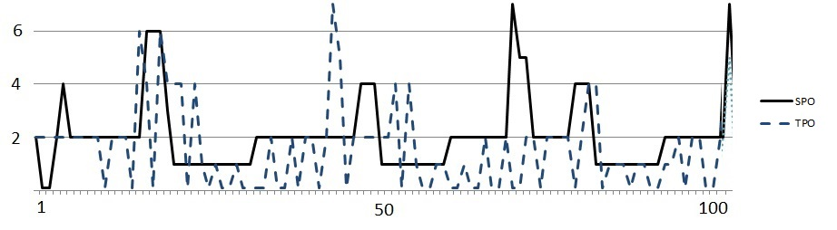
Decision Workload
p-value = 0.683
Combined p-value = 0.070
Notes:
Shows decision workload across the flight phase of 2000 feet to 1500. During this period the pilot is ensuring the plane is configured properly and is mainly monitoring the instruments. In a SPO, the pilot has an additional task to respond to a request from the ground operator which is to respond to a request from the pilot monitoring to arm a certain instrument. Overall we notice that there is not much difference in the decision workload between the two models.

Slide 49
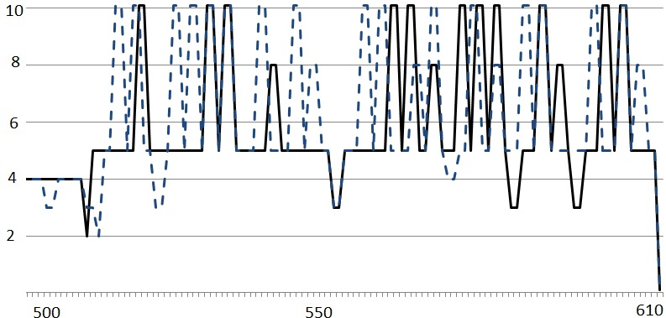
Temporal Workload
P-values
Type | Perception | Decision | Temporal | Combined
SPO/Windy | 0.00255 | 0.854765 | 0.12511 | 0.0439
Notes:
compares the temporal workload of the SPO in reg- ular weather conditions (denoted by the dashed line in Fig. 6) and SPO in windy conditions (denoted by the solid line in Fig. 6) during the final phase of approach. Again the y-axis represent the temporal workload values while the x- axis denotes time in the execution. The windy conditions impact the stability of the plane. In order to stabilize the plane the pilot adjusts his yoke more often in addition to the tasks that he was already performing. This causes ad- ditional spikes in the temporal workload of the SPO model under windy conditions.
In order to check if the differences in workloads were sta- tistically significant, we computed the p-values comparing the workloads values of the SPO and TPO for the different phases of flight as well as the workload values of the SPO under normal weather conditions and SPO under windy con- ditions. The results are presented in Table 1. The low p- values for the perceptual and temporal workloads indicates that that there is a statistically significant difference in the workload measures. Whereas as the higher p-value for the decision workload seems to indicate that the is no statisti- cally significant different in the workload measures. There is a difference in the overall instantenous workload.

Slide 50
Discussion
Higher workload to maintain situational awareness in SPO versus TPO
Situational awareness connected to 88% of air carrier accidents related to human error
SPO concepts need mitigation strategies to help distributed pilot teams with situational awareness
That can be new automation, procedures, etc.

Slide 51
User Study and Validation
New Stuff

Slide 52
Validation Plan
Validate that 2ndary task performance measures workload
Correlate model predictions with secondary task performance

Slide 53
Design Principles
User study to elicit different levels and types of workload
Scenario/Workload | Low | High | Time-Varying
Disney Easy |  | Tetris
Disney Hard |  | Tetris
Nature Easy |  | Math | Half Math
Nature Hard |  | Math | Half Math
Workload levels manipulated with secondary tasks
Scenarios vary primary task workload

Slide 54
Measures
Verify secondary task performance as indicative of workload
Gather data for use in phase 2
Verify that NASA TLX scores, obtained at different times, correspond to secondary task performance?
Gather: acquire time series data of secondary task performance
Hypothesis: secondary task performance is inversely proportional to NASA TLX scores at a significant level

Slide 55
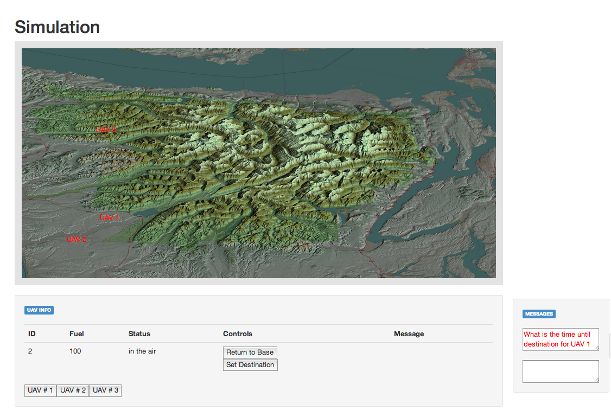
Experimental Setup
2ndary task area
Map area
Task list area
Chat area
Status area
Notes:
Need to know how many people participated in the study!

Slide 56
Need a screen shot of Disney interface

Slide 57
Timeline: Disney Easy vs. Disney Hard
Phase 1
Manage, monitor, and report on 1-2 UAVs
Phase 2
Manage, monitor, and report on 1-4 UAVs
Phase 3
Manage, monitor, and report on 1-4 UAVs
Play tetris
Rate = r + Δ_{small}
Rate = r
Rate = r + Δ_{small}
Phase 1
Manage, monitor, and report on 1-2 UAVs
Phase 2
Manage, monitor, and report on 1-4 UAVs
Phase 3
Manage, monitor, and report on 1-4 UAVs
Rate = r
Rate = r + Δ_{big}
Play tetris
Rate = r + Δ_{big}
Notes:
Tetris only played in Disney scenarios, and only in part 2
Math problems were only done in the nature scenarios
All phase 1’s: control one-2 UAVs, no secondary task
Phase 2 and phase primary tasks were the same, and harder than phase 1: increasing the frequency of the chat commands (reroute or report on something or start)
Easy had a smaller increase in primary task difficulty from phase 1 to phase 2 than hard.
For nature, phase 3’s math task started at the same frequency as for phase 2, but in phase three the math problems stopped about half way through.

Slide 58
Timeline: Nature Easy vs. Nature Hard
Phase 1
Manage, monitor, and report on 1-2 UAVs
Phase 2
Manage, monitor, and report on 1-4 UAVs
Phase 3
Manage, monitor, and report on 1-4 UAVs
2-digit arithmetic
Rate = r + Δ_{small}
Rate = r
Rate = r + Δ_{small}
2-digit arithmetic
Stops half way through
Phase 1
Manage, monitor, and report on 1-2 UAVs
Phase 2
Manage, monitor, and report on 1-4 UAVs
Phase 3
Manage, monitor, and report on 1-4 UAVs
Rate = r
Rate = r + Δ_{big}
2-digit arithmetic
Rate = r + Δ_{big}
2-digit arithmetic
Stops half way through
Notes:
2 and 3 digit addition

Slide 59
Disney Easy: Within Scenario Comparisons
p=0.002
p<0.001
p=0.004
Phase 1
Phase 2
Phase 3
Rate = r + Δ_{small}
Play tetris
Rate = r + Δ_{small}

Slide 60
Disney Hard: Within Scenario Comparisons
p<0.001
p<0.001
p=0.245
Phase 1
Phase 2
Phase 3
Rate = r + Δ_{big}
Play tetris
Rate = r + Δ_{big}

Slide 61
Nature Easy: Within Scenario Comparisons
p<0.001
p<0.001
p=0.3369
Phase 1
Phase 2
Phase 3
Rate = r + Δ_{small}
Do Math
Rate = r + Δ_{small}
Math half time

Slide 62
Disney Hard: Within Scenario Comparisons
p<0.001
p<0.001
p<0.001
Phase 1
Phase 2
Phase 3
Rate = r + Δ_{big}
Do math
Rate = r + Δ_{big}
Math half time

Slide 63
54 Across Scenario Comparisons
Phase 1
Phase 2
Phase 3
Phase 1
Phase 2
Phase 3

Slide 64
54 Scenario Comparisons

Slide 65
Phase 1 Comparisons
Disney Easy-1
Disney Hard-1
Nature Easy-1
Nature Hard-1
p=1.0
p=0.5827
p=0.6146
p=1.0
p=1.0
p=0.93
Notes:
Tukey-kramer adjusted p-values
All easy designed to have same workload

Slide 66
Hard vs. Easy: NASA TLX Total
Disney Easy-2 is easier than Disney Hard-2 (p=0.025)
Disney Easy-3 is easier than Disney Hard-3 (p=0.0274)
The primary task was easier in the easy scenario than the hard scenario
Nature Easy-2 marginally easier than Nature Hard-2 (p=0.0985)
Nature Easy-3 not easier than Nature Hard-2 (p=0.6467)
The primary task was not easier in the easy scenario than the hard scenario

Slide 67
Conclusions From Comparisons
Easy scenarios are easier than the hard scenarios
f(6,32)=5.30, p<0.001
When math is added, the combined (primary-secondary) task for nature easy and nature hard were marginally different or not different.

Slide 68
Does secondary task performance concur?

Slide 69
Disney Easy is easier than Disney Hard
Tetris: F(1,22)=29.76, p<0.001
TLX total: F(3,66)=16.50, p<0.001
P values in pairwise t-test < 0.001

Slide 70
Nature Easy is easier than Nature Hard
Math Time: F(1,22)=11.00, p=0.0031
TLX Total: F(3,66)=16.50, p=<0.001
P values in pairwise t-test < 0.001

Slide 71
Does a Brahms model of the user study, without the secondary task, agree with the findings?

Slide 72
Brahms Model
Map: From UAV Operator Interface
Task List:
From Mission
Manager
Status: From UAV Operator Interface
Chat: From Mission Manager

Slide 73
Add Results Monday

Slide 74
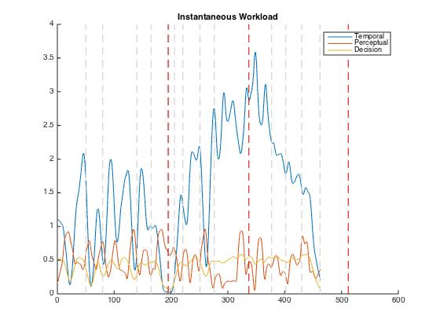

Slide 75
END OF PRESENTATION

Slide 76



Meet the Students
Robert Ivie | Jared Moore | TJ Gledhill

Slide 77
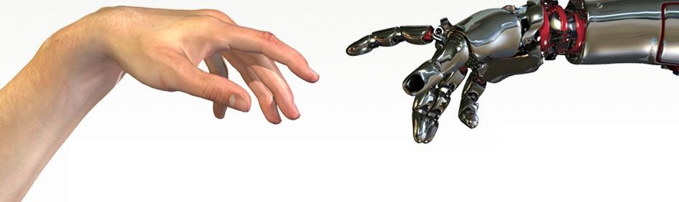
Questions?

